Slide 1

BTH645 - Multimedia Elements for User Interfaces
Shi, Yue (Sunny)
Office: DB2095
sunny.shi@senecacollege.ca
SENECA COLLEGE

Slide 2
Outline
Introduction to animation
Computer-generated animation
File formats used in animation
Summary

Slide 3
Animation
http://vimeo.com/36757477

Slide 4
Introduction to Animation
Animation is the process of creating a continuous motion and shape change illusion by means of the rapid display of a sequence of static images that minimally differ from each other.
It is concerned with the visual or aesthetic aspect of the project.

Slide 5
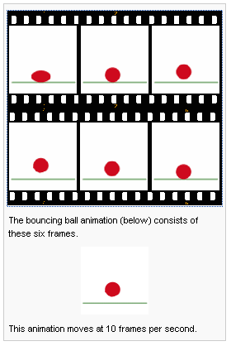
Introduction to Animation
Animation is possible because of a biological phenomenon known as persistence of vision and a psychological phenomenon called phi.
Example Animation: http://en.wikipedia.org/wiki/Animation

Slide 6
Introduction to Animation
A simple form of animation is a transition.
Wipe
b) Fade
c) Zoom
d) Dissolve
http://www.animfactory.com/

Slide 7
Introduction to Animation
Animation can be rendered in:
2-D space - 2-D animations are very simple and static.
2-1/2D space - An illusion of depth is created through shadowing, highlighting, and forced perspective, though in reality the image rests in two dimensions.
3-D space - Complicated and realistic animations are done in 3-D space.

Slide 9
How does animation work?
1. Animation is possible because of persistence of vision.
a) Images remain chemically mapped in the eye briefly.
2. Still images are flashed in a sequence to produce an illusion of movement.
3. The speed at which the image changes is called the frame rate.
a) Movies on film are delivered at 24 frames per second (fps).
b) National Television Standards Committee (NTSC) television is delivered at 30 fps.

Slide 10
Animation techniques
Cel animation
Computer animation

Slide 11
Cel Animation
Cel animation is a technique in which a series of progressively different graphics are used on each frame of movie film.
The term “cel” is derived from the clear celluloid sheets that were used for drawing each frame.
Cel animation begins with keyframes.

Slide 12
Cel Animation
The frames that show the beginning and end of some action are called Keyframes.
The process of filling in the action is called tweening..

Slide 13
Computer-Generated Animation
Computer animation is very similar to cel animation.
Keyframes and tweening techniques are often used.
The primary difference is in how much must be drawn by the animator and how much is automatically generated by the software.
http://muffinfilms.com

Slide 14
Computer-Generated Animation
Kinematics is the study of motion of joint structures (such as people).
Realistic animation of such movement can be complex.
Inverse kinematics is the process of linking objects, and defining their relationship and limits.

Slide 15
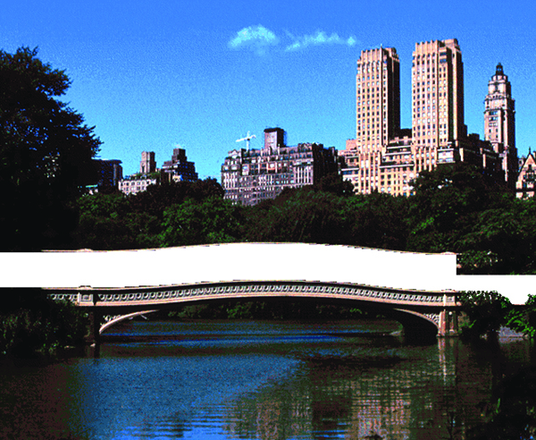
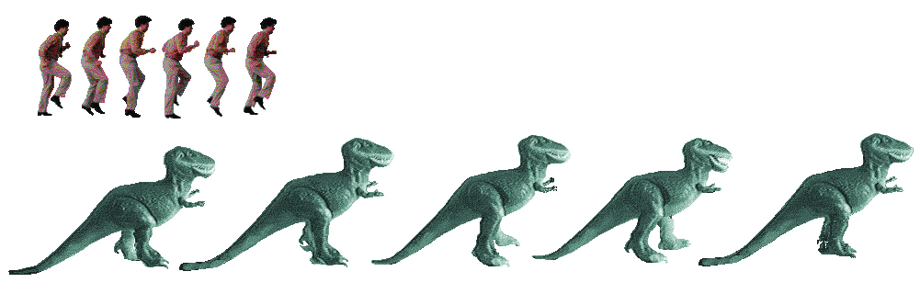
Computer-Generated Animation
Making GIF animations

Slide 16
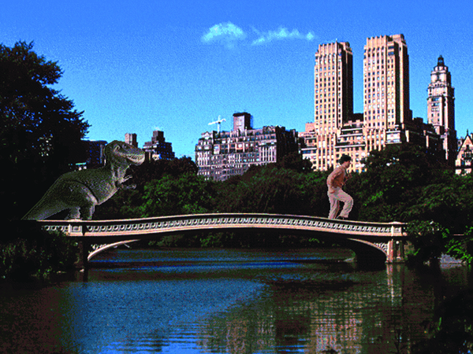
Computer-Generated Animation
Making GIF animations

Slide 17
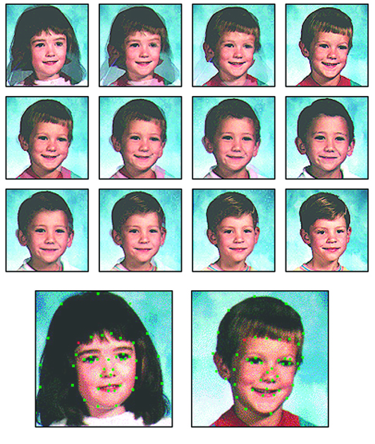
Computer-Generated Animation
Morphing is the process of transitioning from one image to another.
When morphing, set key elements (such as a nose) to share the same location.

Slide 18
Making Successful Animations
Use animation carefully and sparingly.
High-quality animations require superior display platforms and hardware, as well as raw computing horsepower.
File compression is very important when preparing animation files for the Web.

Slide 19
Making Successful Animations
Some animation tools are:
OpenGL: a cross-language, cross-platform application programming interface (API) for rendering 2D and 3Dvector graphics. The API is typically used to interact with a graphics processing unit (GPU), to achieve hardware-accelerated rendering.
AutoDesk’s Maya: a 3D computer graphics application that runs on Windows, macOS and Linux. create interactive 3D applications, including video games, animated film, TV series, or visual effects.
Lightwave 3D: 3D computer graphics software developed by NewTek. It has been used in film, television, motion graphics, digital matte painting, visual effects, video games development, product design, architectural visualizations, virtual production, music videos, pre-visualizations and advertising.
Papervision3D: open source, 3D graphics engine for rendering 3D content within Adobe Flash Player and Adobe AIR
GreenSock’s TweenMax: JavaScript library for high-performance HTML5 animation in all major browsers. Popular, reliable and fast.
Adobe’s Flash: multimedia software platform used for production of animations, rich Internet applications, desktop applications, mobile applications, mobile games and embedded web browser video players. Flash displays text, vector graphics and raster graphics to provide animations, video games and applications.

Slide 20
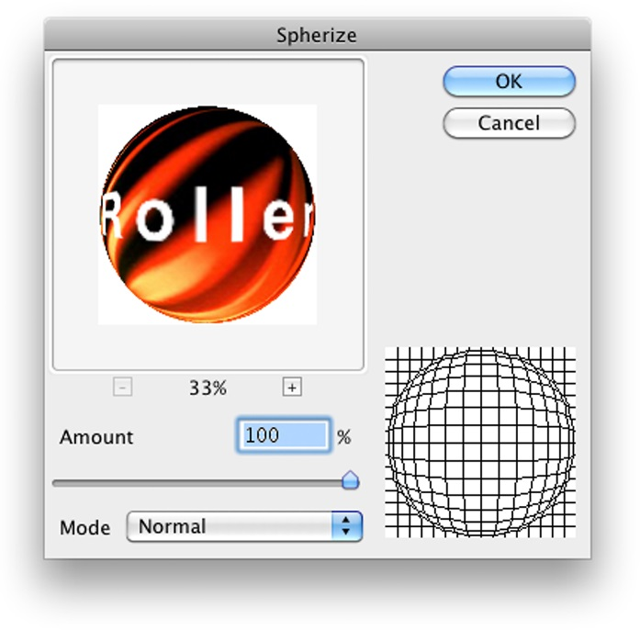
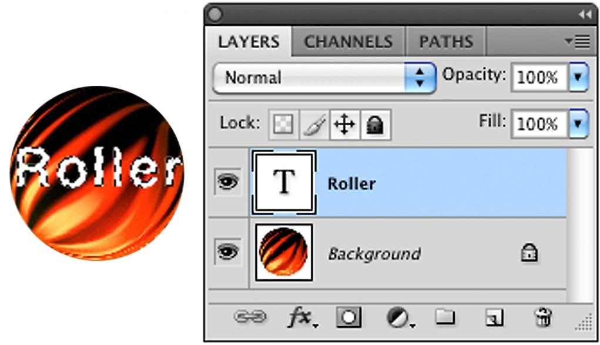
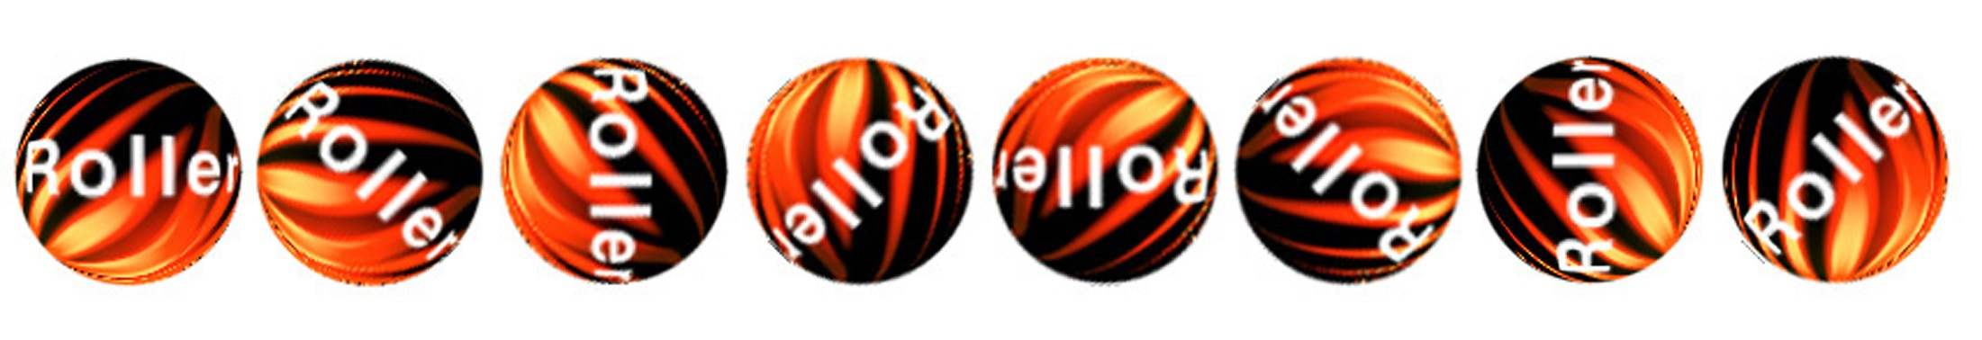
Making Successful Animations
A rolling ball: to create a realistic rolling effect, calculate the circumference of the ball to specify the movement.

Slide 21
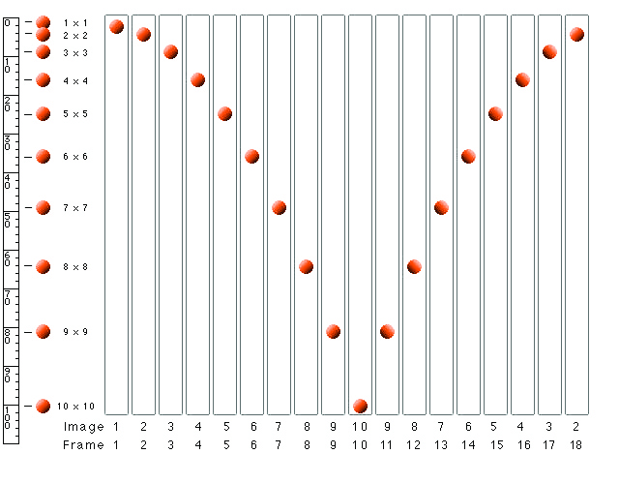
A bouncing ball:
(1) gravity makes the ball speed up as it falls and slow down as it rises.
(2) Calculate gravity using s=1/2gt².
s=distance, g=acceleration, t=time.
(3) Precise acceleration numbers are less important than good timing for your animation.

Slide 22
File Formats Used in Animation
.avi, .asf, .wmv: Windows Media files
.dir and .dcr - Director files
.fli and .flc - AnimatorPro files
.max - 3D Studio Max files
.pics - SuperCard and Director files
.fla and .swf - Flash files
.qt, .mov: Apple QuickTime files
.mpeg, .mpg: motion video files
.svg - scalable vector graphics files, which are new to HTML 5
.gif (GIF) files also support animation

Slide 23
File Formats Used in Animation
GIF89a file format:
It is a version of the GIF image format.
GIF89a allows multiple images to be put into a single file and then be displayed as an animation in the web browser.
Applications like Stone Design’s GIFfun or ULead’s GIF Animator are needed to create GIF89a animation.

Slide 24
Types of Animation
1. Traditional Animation
long-drawn process.
Much time and energy are invested for drawing each frame.
For every movement like the flick of a finger or demonstration of an emotion on the face, a number of frames is needed.
Reference: https://mapsystemsindia.com/resources/various-uses-of-animation.html

Slide 25
Types of Animation
2. 2D Animation
vector-based just like traditional animation.
frames are not drawn manually,
instead a computer program like Flash or Adobe Animate is used.
Reference: https://mapsystemsindia.com/resources/various-uses-of-animation.html

Slide 26
Types of Animation
3. 3D Animation
need advanced 3D modeling software
Reference: https://mapsystemsindia.com/resources/various-uses-of-animation.html

Slide 27
Types of Animation
4. Animation through Motion Graphics
Graphical elements are moved around.
Commonly visible in infotainment videos, film titles, animated logos, promotional campaigns, and advertisements.
Reference: https://mapsystemsindia.com/resources/various-uses-of-animation.html

Slide 28
Types of Animation
5. Stop Motion Animation
Starts with the photographing of an object in a succession of images .
Each image is a representation of a subtle motion of the object.
The movements should be carefully filmed in the correct order.
This adds a feel of fluidity to the animation while eliminating the chances of sudden scene-breaks.
Reference: https://mapsystemsindia.com/resources/various-uses-of-animation.html

Slide 29
Types of Animation
6. Cutout and Collage Animation
models used are cut from craft or drawing paper.
The puppets can be drawn or painted over.
These cutout portions are placed loosely alongside each other.
They can be arranged after connecting with fasteners.
After capturing each movement or model pose, repositioning of the model takes place for taking newer shots.
Reference: https://mapsystemsindia.com/resources/various-uses-of-animation.html

Slide 30
Types of Animation
6. Cutout and Collage Animation
In collage animation, the process followed is usually similar to cutout animation.
The difference is that parts which have to be animated are cutouts of clipart, magazines, books and images.
In the animation shows broadcasted over television, usually the cutout and collage animation type is used. Well cut out characters are animated using collage method.
Reference: https://mapsystemsindia.com/resources/various-uses-of-animation.html

Slide 31
Types of Animation
7.Rotoscoping
This animation method is used for capturing human movements realistically.
live footage of the actors is shot followed by drawing of the characters over it.
Reference: https://mapsystemsindia.com/resources/various-uses-of-animation.html

Slide 32
Types of Animation
8. Cel Animation
transparent cellulose acetate sheet is called cel where the animated frame can be painted
Reference: https://mapsystemsindia.com/resources/various-uses-of-animation.html

Slide 33
Areas that Animation is used
1. Education:
Enhance the reception levels of students.
2. Entertainment:
Tom and Jerry, Mickey Mouse and Donald Duck
3. Advertisement:
plays an important role in making effective commercials that can capture the imagination of the audience luring them to buy the product being advertised.
Reference: https://mapsystemsindia.com/resources/various-uses-of-animation.html

Slide 34
Areas that Animation is used
4. Marketing:
brings lots of creativity to your marketing, which helps to reach more demographics.
5. in Scientific Visualization:
extensively used to create accurate and representative scientific visualization for the purpose of research and analytical studies
E.g., in medical diagnosis where parts of body can be effectively studied and problems can be diagnosed more efficiently.
Reference: https://mapsystemsindia.com/resources/various-uses-of-animation.html

Slide 35
Areas that Animation is used
6. Creative Arts:
Motion graphics is extensively used to demonstrate and generate the skills required to attend a certain level of creative proficiency.
7. Gaming:
an industry where everything is dependent on animation as most 3D characters for games are created with animation
Reference: https://mapsystemsindia.com/resources/various-uses-of-animation.html

Slide 36
Areas that Animation is used
8. Simulations:
Simulations are utilized in areas where real life training of people is dangerous or cannot be controlled.
E.g., Military training exercises,
pilots training,
organizations use it to predict the outcome of a range of activities.
Reference: https://mapsystemsindia.com/resources/various-uses-of-animation.html

Slide 37
Areas that Animation is used
9. Medical:
allows professionals and medical students to visualize the details of the human anatomy with clarity.
10. Retail:
The marketers use animations to showcase product attributes to their customers.
3D modeling and animation can interpret the functions of a product, along with its features in a lucid manner.
Reference: https://mapsystemsindia.com/resources/various-uses-of-animation.html

Slide 38
Areas that Animation is used
11.Architecture and Engineering
In architecture, it is necessary to explain the proposed designs to potential customers in a simplified manner.
can be produced in quick time and reasonable costs.
12. Manufacturing
develop virtual models of various products in the manufacturing sector
Reference: https://mapsystemsindia.com/resources/various-uses-of-animation.html

Slide 39
Summary
Animation is visual change over time and adds great power to multimedia.
Cell animation uses a series of progressively different graphics on each frame of movie film.
Computer animation has eased the process of creating animation.
Many file formats are designed specifically to contain animation.
A variety of types of animation.
Areas that Animation can be used are almost limitless.

Slide 40
Thank you!

